Slide 1
Destructors
As you may have guessed a destructor de-constructs
class String {
private:
char *s;
int size;
public:
String(char *);
~String(); };
String::String(char *c) {
size = strlen(c);
s = new char[size+1];
strcpy(s,c); }
String::~String(){
delete []s; }
As opposed to the constructor,
the destructor destructs or deletes
A destructor is declared as
the name of the constructor with ‘~’ in front
Notice how it deletes the array

Slide 2
#include <iostream>
using namespace std;
int main() {
int* ptra = new int;
int* ptrb = new int(42);
cout << "*ptra : " << *ptra << endl;
cout << "*ptrb : " << *ptrb << endl;
delete ptra;
delete ptrb;
cout << "*ptra : " << *ptra << endl;
cout << "*ptrb : " << *ptrb << endl;
ptra = nullptr;
ptrb = nullptr;
//if(ptra == nullptr) cout << "*ptra : nullptr" << endl; else
cout << "*ptra : " << *ptra << endl;
//if(ptrb == nullptr) cout << "*ptrb : nullptr" << endl; else
cout << "*ptrb : " << *ptrb << endl;
return 0; }
delete
new tells the operating system to allocate enough memory and then return the starting address of this memory. This address is put into a ptr.
The delete keyword deletes the object that a pointer points to
It does not delete the pointer
!!!Once memory has been deleted it must never be used again other wise it will very likely crash the program.
To clear the pointer as well
Set it to null pointer
Remember some data are more complex than others
What do you think happens for LinkedList ?

Slide 3
These are not the same
The code used
The code demonstrated
≠
Node
Node
next
next
Not needed
data
data
~Node {
public:
//delete *data;
//delete *next; };
class Node {
public:
Node *next;
int data; };
class Node {
public:
Node *next;
Node *data; };
This is why
This will delete the next node
Here using Node instead of Datatype
This was to help visualise how a node works

Slide 4
LinkedList
When using datatypes
int length = 3;
node
node
node
LinkedList::~LinkedList() {
while(this->head != nullptr){
Node* temp = this->head;
this->head = this->head->next;
delete temp; }
cout << "Linked list deleted!" << endl; }
head
next
next
next
data
data
data

Slide 5
LinkedList
Remember LinkedList ?
int length = 3;
node
node
node
LinkedList::~LinkedList() {
while(this->head != nullptr){
Node* temp = this->head;
this->head = this->head->next;
//delete temp->data;
delete temp; }
cout << "Linked list deleted!" << endl; }
head
next
next
next
data
data
data
data
data
data
This is not needed
Demo purposes only

Slide 6
OurStack
head
When using datatypes
int length = 3;
OurStack::~OurStack(){
while(this->head != nullptr){
Node* temp = this->head;
this->head = this->head->next;
delete temp; } }
node
data
next
node
data
next
node
data
next

Slide 7
OurStack
head
Remember Stack ?
int length = 3;
OurStack::~OurStack(){
while(this->head != nullptr){
Node* temp = this->head;
this->head = this->head->next;
//delete temp->data;
delete temp; } }
node
data
data
next
node
data
data
This is not needed
Demo purposes only
next
node
data
data
next

Slide 8
LinkedList
Another way to illustrate this problem
int length = 3;
node0
node1
node2
What happens when we erase node1 without handling the before next pointer?
head
next
next
next
data
data
data
data
data
data

Slide 9
LinkedList
int length = 3;
node0
node2
The chain brakes
head
next
next
data
data
data
data

Slide 10
LinkedList
Set the temporary one to be deleted
int length = 3;
temp
node0
node2
The next pointer of the node before must be set to the node next pointer
head
next
next
data
data
node1
data
next
data
data
data

Slide 11
LinkedList
int length = 3;
temp
node0
node2
Delete temp
head
next
next
data
data
data
next
data
data
If data is a datatype

Slide 12
Templates
It essentially lets us use methods with any datatype
Instead of variables being used parameters
Templates allows to pass datatypes as parameters
#include <iostream>
using namespace std;
template <typename T>
T myMax(T x, T y) {
//if(x > y) return x; else return y;}
return (x > y)? x: y; }
int main() {
cout << myMax<int>(10, 42) << endl;
cout << myMax<double>(0.0001, 101.01) << endl;
cout << myMax<char>('z', 'a') << endl;
return 0; }
<typename> can be replaced with use <class> keyword instead and enumerate them
#include<iostream>
using namespace std;
template<class T, class U>
class A { T x; U y;
public: A() { cout << "Constructor called" << endl; } };
int main() {
A<char, char> a;
A<int, double> b;
return 0; }
template myMax<typename int>
int myMax(int x, int y) {
return (x > y)? x: y; }
template myMax<typename char>
char myMax(char x, char y) {
return (x > y)? x: y; }
What is the equivalent of Templates in JAVA ?

Slide 13
Sequence containers
#include <iostream>
#include <array>
#include <vector>
#include <deque>
#include <list>
using namespace std;
int main() {
char str[] = {'H','e','l','l','o','\0'};
//array<char,6> str = {'H','e','l','l','o','\0'};
//vector<char> str = {'H','e','l','l','o','\0'};
//deque<char> str = {'H','e','l','l','o','\0'};
//list<char> str = {'H','e','l','l','o','\0'};
for(char chr: str){
cout << chr; }
return 0; }
Container adaptors
Base Standard
Array:
array<char,size> str;
Push()
Stack: LIFO
stack<char> str;
Pop()
Vector:
vector<char> str;
What is the equivalent of deque in JAVA ?
Deque (double-ended-queue):
deque<char> str;
Push()
Queue: FIFO
queue<char> str;
Pop()
Dynamic
Forward List:
forward_list<char> str;
Push()
Priority Queue: Organised
priority_queue<char> str;
List:
list<char> str;
Pop()
Sequence container are “built from scratch”
Different data structure and algorithm time
Insert(), delete(), get()
Container adapter are
behaviours added on top of Sequence Container
Data is controlled by push(), pop()
Notes:
Vector uses more memory than Arrays
Deque are both Base Standard and Dynamic sequence containers
Nodes can be inserted in a linked list by playing around with the pointers
In an array, you need to copy and paste everything further down

Slide 14
Template for the Node class for a List
Node
prev
next
#ifndef DNODE_H
#define DNODE_H
template <typename dataType> struct dnode {
dataType data;
dnode *prev, *next;
// constructors
dnode() : prev(NULL), next(NULL) {}
dnode(const dataType& dataItem, dnode *prevPtr, dnode *nextPtr) : data(dataItem), prev(prevPtr), next(nextPtr) {} };
#endif
data
data
Here the node for a list uses a datatype

Slide 15
List
int length = 3;
node
node
node
Forward list only point towards the next* node
previous
previous
previous
tail
list points towards the next* node and the previous* node
head
next
next
next
data
data
data
data
data
data

Slide 16
Interators
Iterators are used to point to a memory address for containers
Like a pointer of an index
#include <iostream>
#include <vector>
#include <list>
using namespace std;
int main() {
int ints[] = {10,9,8,7,6,5,4,3,2,1};
vector<int> intscontainer (ints, ints+10);
//list<int> intscontainer (ints, ints+10);
for (vector<int>::iterator i=intscontainer.begin();
i!=intscontainer.end();
++i)
cout << *i << ' ' << endl;
cout << "Happy New Year";
return 0; }
Can use any standard container type
!!!Not container adaptor
begin() returns the beginning position
end() returns the after end position
Remember to change vector to list

Slide 17
O
Estimate the amount of “processing” an algorithm will use
By “counting” the most complex operation
Big
What’s the point of big O ?
To give engineers the means to mentally assess and compare algorithms
Algorithm differ in complexity
however more complex doesn’t always mean more efficient
big O is meant to consider the worst case where the variable approaches infinity
https://www.desmos.com/calculator

Slide 18
If f(n) and g(n) are functions defined for positive integers of n,
then f(n) is O(g(n))
If there is a constant c such that f(n) <= c g(n) for all sufficiently large integers of n
then we say f(n) is Order of g(n)
If f (n) = c × g(n) + h(n)
With c g(n) >= h(n) for sufficiently large n
Then f (n) is O(g(n))

Slide 19
For example using the Fibonacci algorithm
This algorithm uses 5 declared variable
and 1 for loop
This method uses 1 declared variable
but a recursive algorithm
Which do you think will run faster ?
#include<iostream>
using namespace std;
int fib(int n) {
int a = 0, b = 1, c, i;
if( n == 0) return a;
for (i = 2; i <= n; i++) {
c = a + b;
a = b;
b = c; }
return b; }
int main () {
int n = 75;
cout << fib(n);
return 0; }
#include<iostream>
using namespace std;
int fib(int n) {
if (n <= 1) return n;
return fib(n-1) + fib(n-2); }
int main () {
int n = 45;
cout << fib(n);
return 0; }
O(n) for Fibonacci linear
O(2^n) for Fibonacci recursive
A for loop is O(n)
A nested for loop is O(n^2)
The order of any expression can be determined by
keeping the dominant term within the expression.
You might be programming for legacy hardware.
Take the most complex operation and quantify
Notes:
Solution here (resize notes to be one line)
Fibonacci Linear is O(n) because of the for loop
Fibonacci Recursion is Fib(n) = Fib(n-1)+Fib(n-2);
Fib(n) = O(2^n-1)+0(2^n-2) = O(2^n);

Slide 20
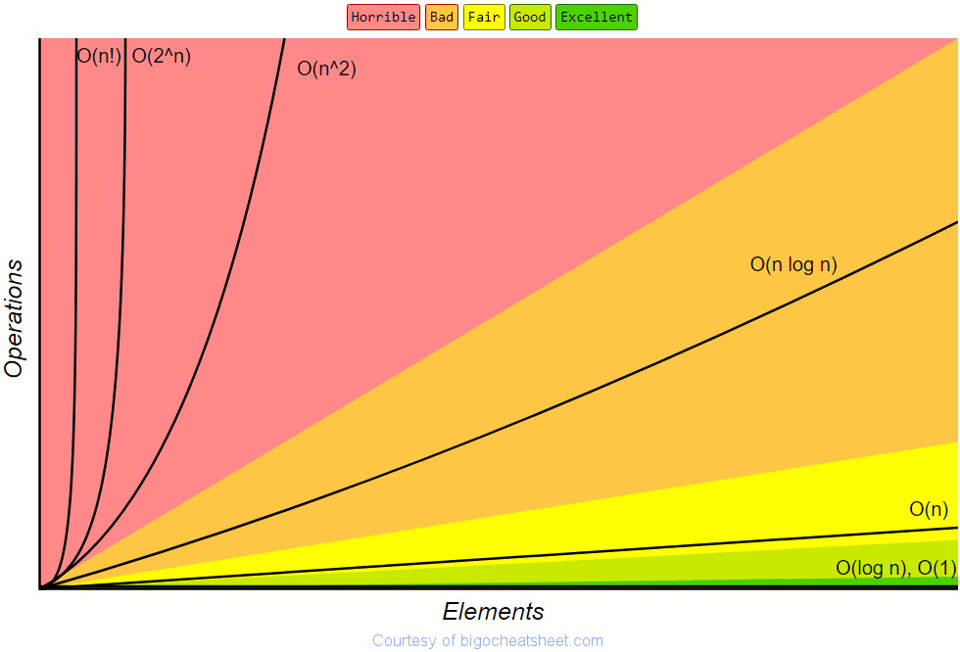
Notice these
https://www.bigocheatsheet.com/

Slide 21
O() | Name | Phone book
1 | Constant | Given the page that a business's name is on and the business name, find the phone number. Given the page that a person's name is on and their name, find the phone number.
Log n | Logarithmic | Given a person's name, find the phone number by picking a random point about halfway through the part of the book you haven't searched yet, then checking to see whether the person's name is at that point. Then repeat the process about halfway through the part of the book where the person's name lies. (This is a binary search for a person's name.)
n | Linear | Find all people whose phone numbers contain the digit "5". Given a phone number, find the person or business with that number.
n log n | Log Linear | There was a mix-up at the printer's office, and our phone book had all its pages inserted in a random order. Fix the ordering so that it's correct by looking at the first name on each page and then putting that page in the appropriate spot in a new, empty phone book. We want to personalize the phone book, so we're going to find each person or business's name in their designated copy, then circle their name in the book and write a short thank-you note for their patronage.
n² | Quadratic | A mistake occurred at the office, and every entry in each of the phone books has an extra "0" at the end of the phone number. Take some white-out and remove each zero.
2^n 2^{n} | Exponential | We have been through the Fibonacci example
n! | Factorial | We're ready to load the phonebooks onto the shipping dock. Unfortunately, the robot that was supposed to load the books has gone haywire: it's putting the books onto the truck in a random order! Even worse, it loads all the books onto the truck, then checks to see if they're in the right order, and if not, it unloads them and starts over.

